Slide 1

PyTorch-to-FPGA for QNNs with
@ ONNX Community Virtual Meetup, 2020-04-09
Yaman Umuroglu
Xilinx Research Labs

Slide 2
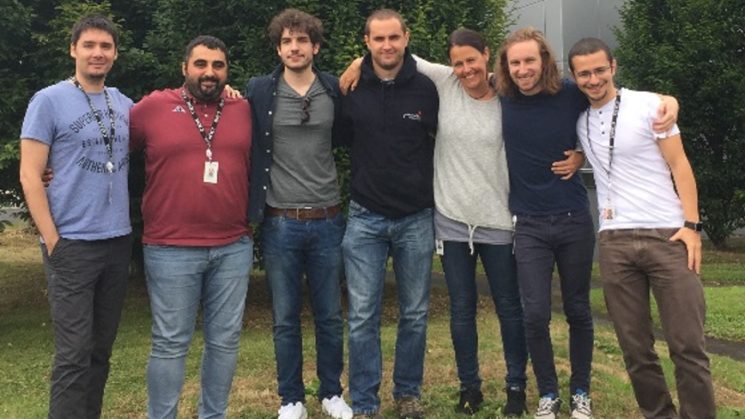
Xilinx Research, Dublin
Established over 14 years ago
Slowly expanding and increasingly leveraging external funding (IDA, H2020)
6 full-time researchers + interns
Applications & Architectures
Quantifying the value proposition of Xilinx devices in machine learning
In collaboration with Partners, Customers and Universities
Lucian Petrica, Giulio Gambardella, Alessandro Pappalardo,
Ken O’Brien, Michaela Blott (leader), Nick Fraser, me (from left to right)

Slide 3
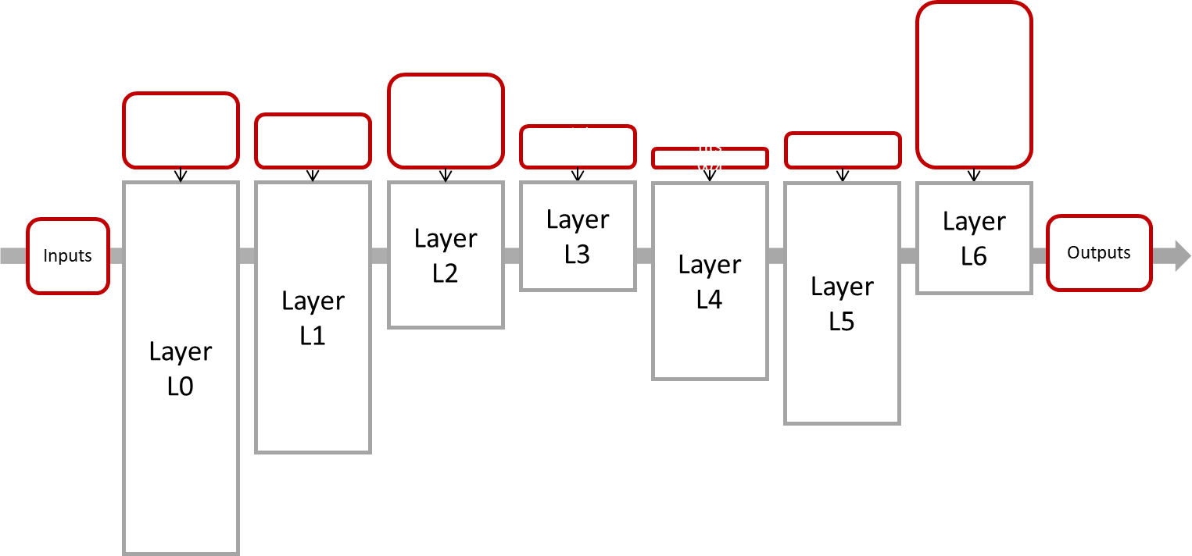
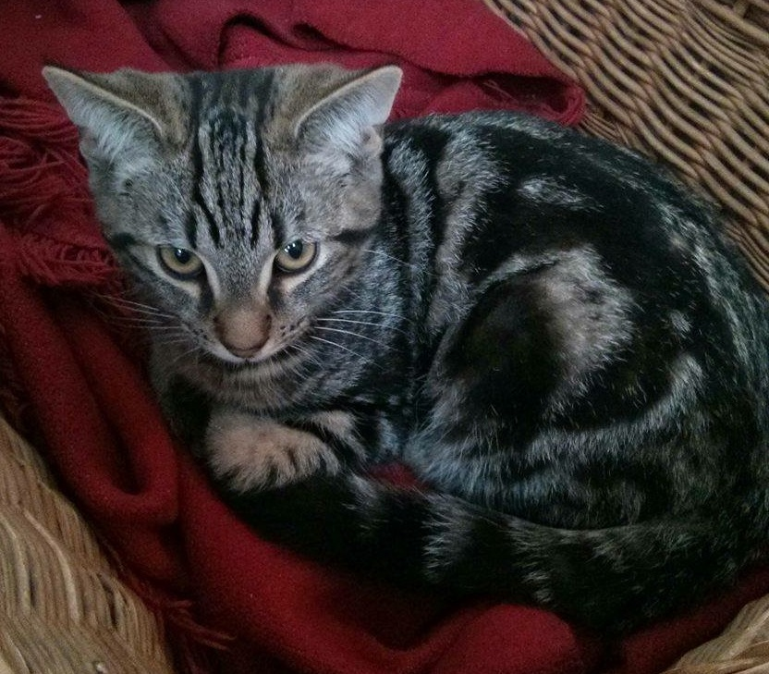
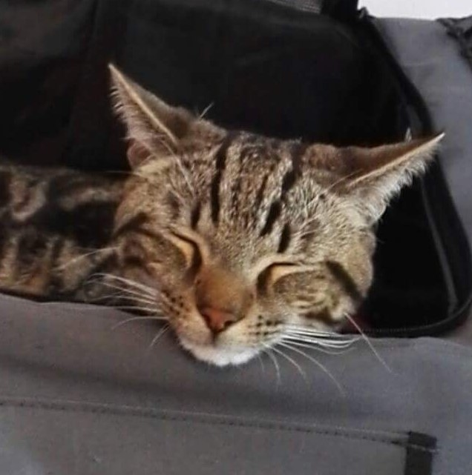
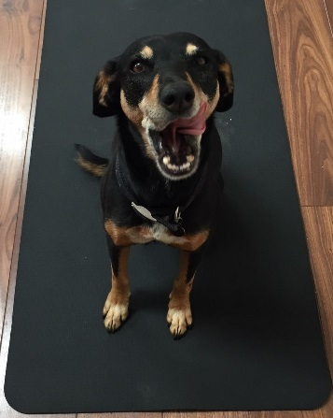
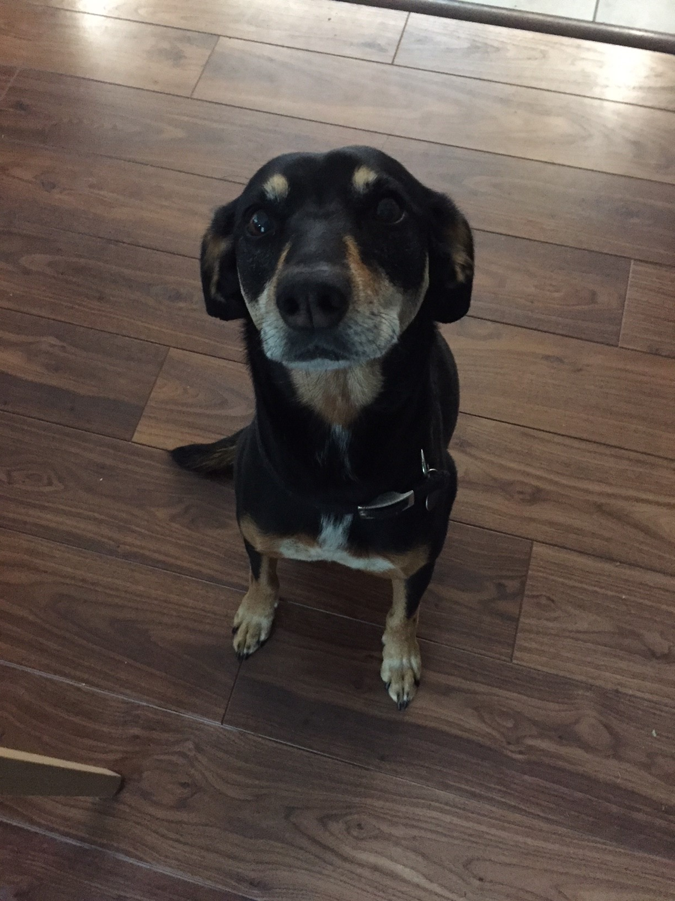
Exploring Custom Hardware + Algorithms for DNNs
+2
* +1
-4
* -1
sum
act.
+1
* -1
+1
k-bit weights and activations, k <= 4
keep all on-chip!
CNN
allocated resource ~ compute requirement
per layer
dog
cat
cat
dog
FPGA
Notes:
Default approach in FINN
Explain what’s going on in the animation, and then play animation (same with the slide before)
Customize both the precision and the structure of the compute engine
Compute engine structure mimics the NN in hardware, all layers process in parallel, in pipeline fashion (animation)

Slide 4
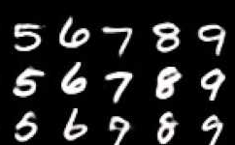
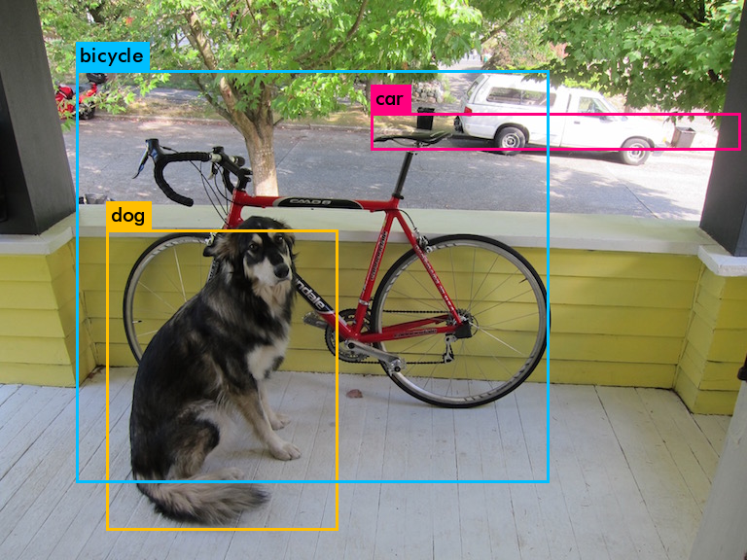
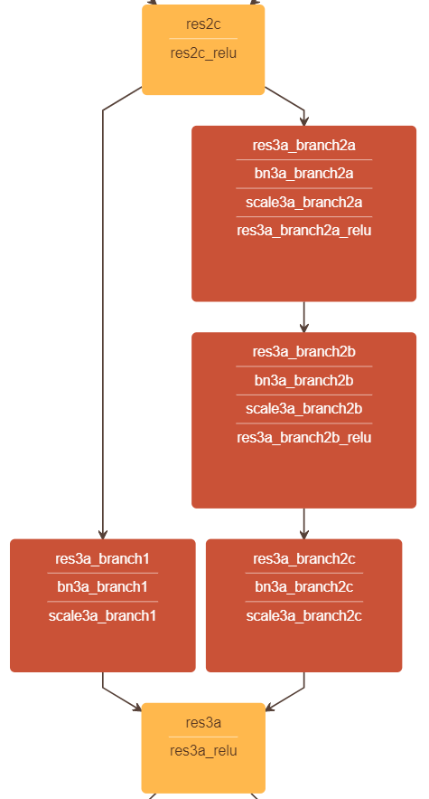
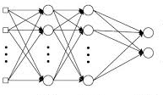
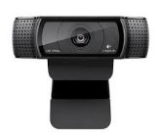
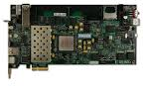
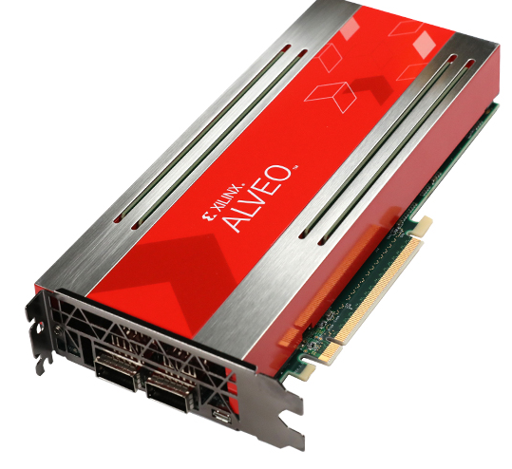
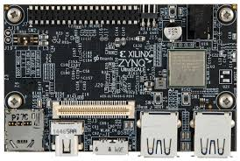
Few-bit QNNs + FPGA Dataflow: Showcases
High Throughput
& Low Latency
Low-Power, Real-Time
Object Detection
Complex
Topologies
MNIST MLP on ZC706
12.3 M FPS
310 ns latency
Tincy-YOLO on Ultra96
55 FPS @ 10 W
ResNet-50 on Alveo U250
2 ms latency
2000 FPS
Notes:
Work on FINN has resulted in a number of technology demonstrators which validate approach at various scales
Multi-layer perceptron acceleration, MNIST but also consider other applications such as high-energy physics
Object detection and clasiffication, relevant to ADAS applications
Object clasiffication for data-center applications

Slide 5
The FINN Project: Mission
Support customizing the algorithms with precision, layer types, topologies
Support hardware architecture exploration around dataflow execution
Flexibility
on
Algorithms
Flexibility
on
Architectures
Codesign
Transparency and flexibility through open source (if not supported, add your own!)
Open source from the ground-up to encourage community contributions
End-to-end flow to lower adoption barrier
Notes:
Key challenge – how do we realize conversion from full precision network to dataflow implementation in FPGA, through codesign;
FINN vision: Enables customization at the neural network level and FPGA accelerator level
Designed as enabler towards FPGA inference for a wider audience
user not customer

Slide 6

The FINN Project: Components of the Stack From PyTorch to FPGA
QNN training in PyTorch
Brevitas
Customization
of Algorithm
Frontends, Transformation, Dataflow Backend
FINN Compiler
Customization
of Hardware
Architecture
Deployment with
Notes:
How we plan to accomplish this mission: stack of modular components
Brevitas provides algorithmic customization, FINN compiler generates hardware accelerators
Designed for easy integration with Pynq, although other runtimes exist

Slide 7
An Overview of the FINN Compiler
ONNX
Python library of graph transformations
Each consumes and produces an ONNX graph
User calls sequence of transformations to create their own flow
Example end-to-end flows to get started
Primary backend target is our own Vivado HLS library
Templated datatypes, configurable parallelism
Import
Streamlining
Hardware Cost Model
Hardware Mapping
Resource Allocation
FINN HLS Library
Code Generator
Synthesizable description
Vivado
Synthesis, PAR
Software Library
Host Run-time
FPGA Platform

Slide 8
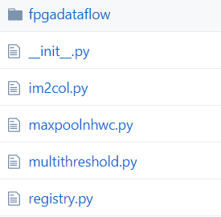

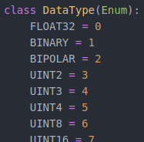
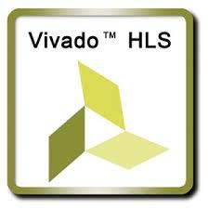

How We Use ONNX in the FINN Compiler
Custom quantization annotations
for few-bit types
Use quantization_annotation
ONNX float32 tensor as container,
values restricted to few-bit types
indicated by type name (string)
Custom op_types
at different abstraction levels
Identified by op_type and domain
Python wrappers to provide
implementations for exec, codegen..
Hybrid runtime to
verify model correctness
Mix onnxruntime, Vivado HLS
C++ and RTL (PyVerilator)
Not performance-oriented

Slide 9
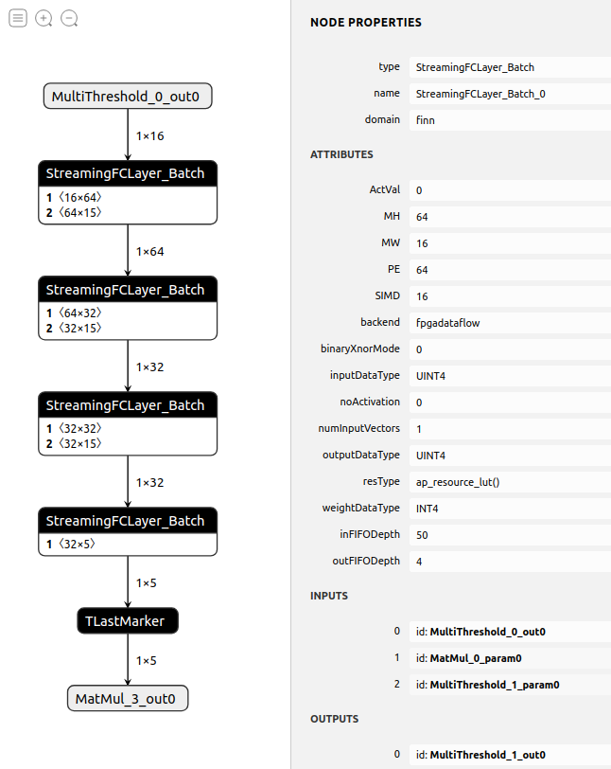
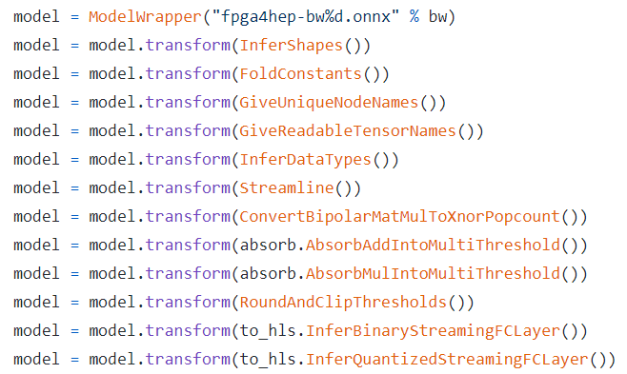
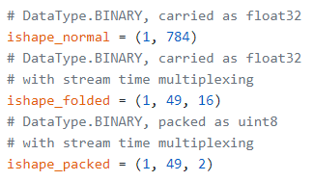
How We Use ONNX in the FINN Compiler
Library of Python
graph transformations
Operating directly on ONNX
representation
Including constant folding, shape
inference, convolution lowering ++
Tensors with custom
data layout and packing
e.g. pack 8x1-bit as 1x8-bit
Utility functions to convert back
and forth
Use Netron for debugging
Visually inspect transformed graphs
Check node attributes, initializers

Slide 10

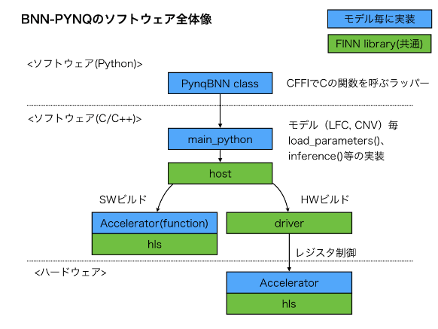
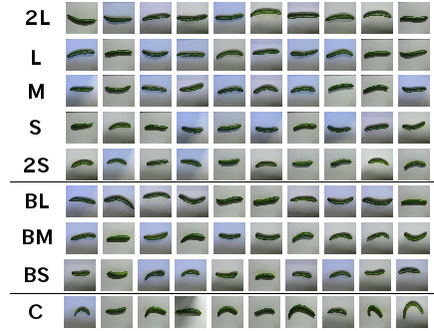


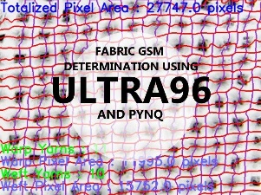
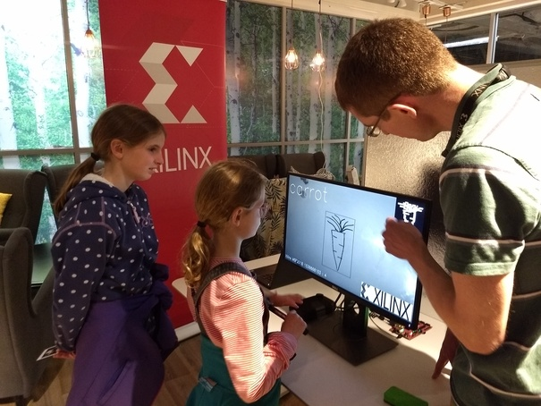


Join our Growing Open-Source Community!
Japanese documentation effort + «cucumber sorting»
University courses, student/hobbyist projects
Sketch Recognition (Xilinx Edinburgh)

